Slide 1
OOP JavaScript
Autumn Frontend Internship 2021

Slide 2
Hi, I’m Paula

Slide 3
Agenda
OOP Concepts
Objects in JavaScript
Prototype and classes
TypeScript
Challenge

Slide 4
Let’s play a game!
Kahoot.it

Slide 5
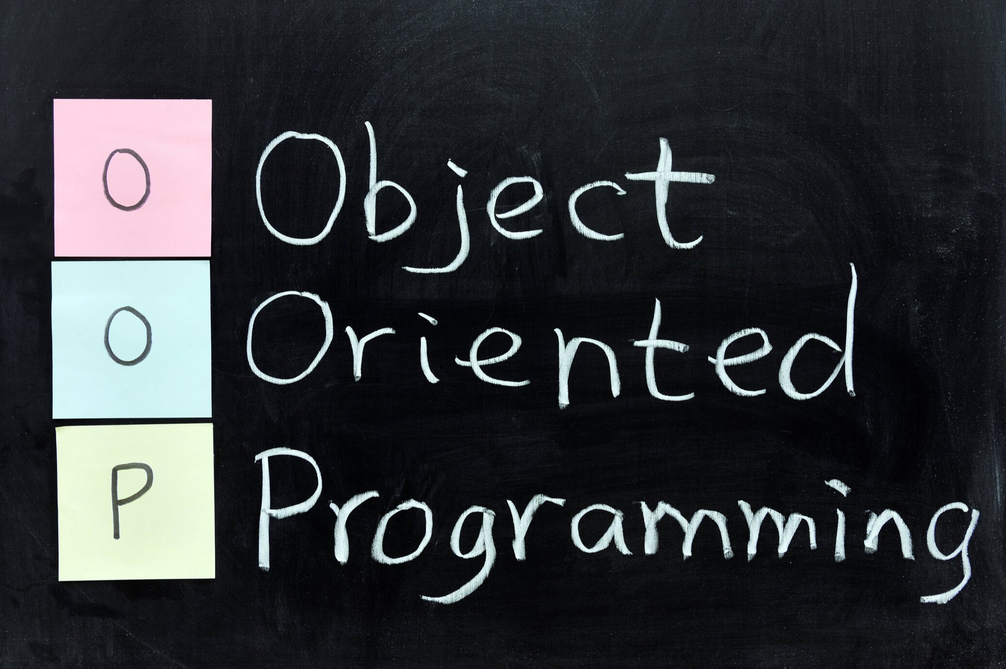

Slide 6
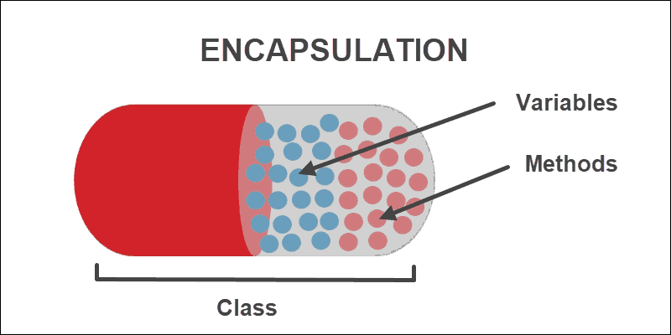
Encapsulation

Slide 7
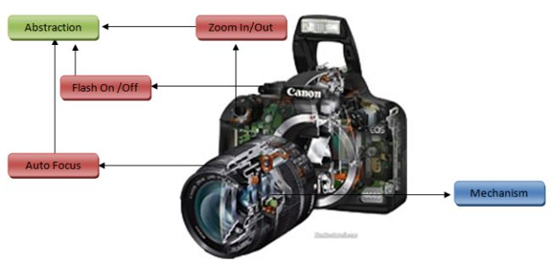
Abstraction

Slide 8
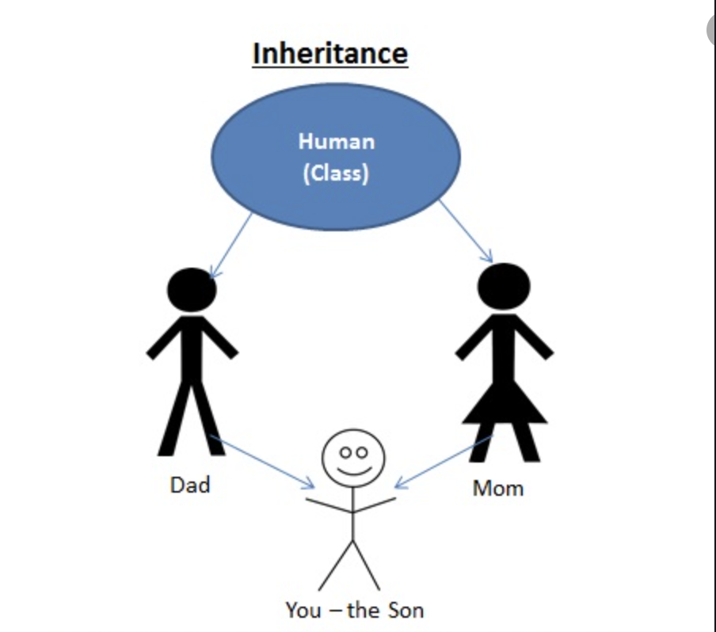
Inheritance

Slide 9
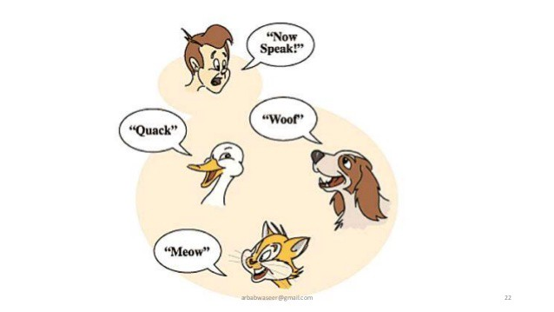
Polymorphism

Slide 10
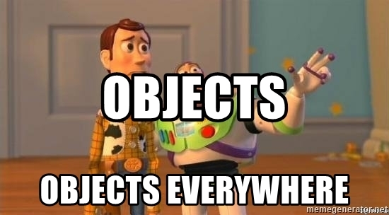
OOP in JavaScript

Slide 11
Objects in JavaScript
Objects are collections of properties and methods which represent data and functionality

Slide 12
Properties and methods
Name/value pair
Dynamic notation: property name as variable
Static notation:
Dot
Bracket

Slide 13
Constructors and instances
3 + 1

Slide 14
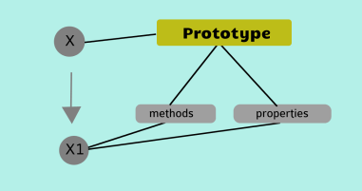
Prototype

Slide 15
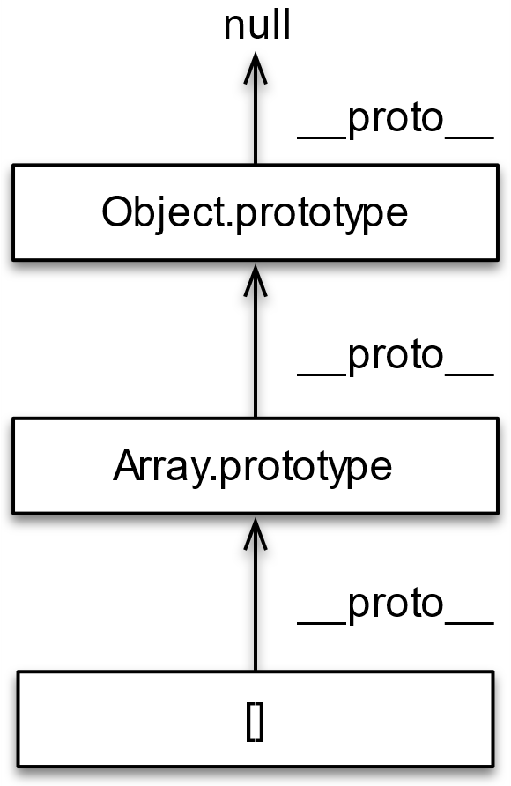
Prototype Chaining

Slide 16
Prototype chaining
Prototype vs __proto__
getPrototypeOf
Instance of
isPrototypeOf

Slide 17
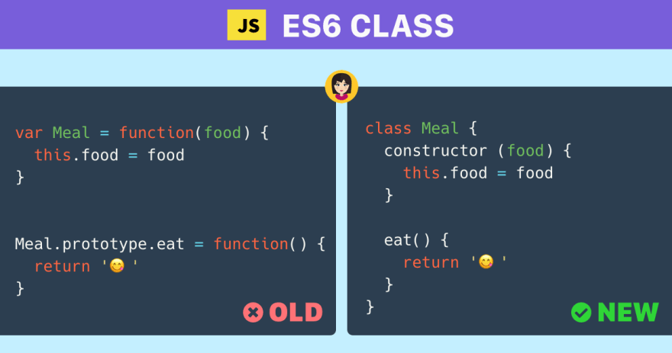
Class

Slide 18
Class
Extends
Super
This

Slide 19


Slide 20

What?

Slide 21
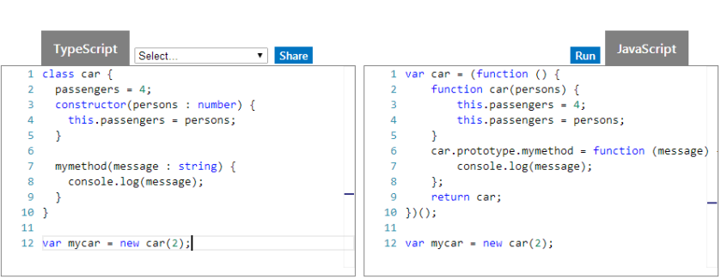

Slide 22

https://github.com/microsoft/TypeScript

Slide 23
How to install?
npm install –g typescript
run tsc file.ts / add compilation task to build script

Slide 24
Advantages
OOP
Easy to debug
Better structuring: modules, classes, interfaces
Proper documentation
Compile time checks
Automatic type inference

Slide 25
Disadvantages
Extra step: transpilation
New syntax

Slide 26
Features
Type Annotations
“any” type
Compile Time Checking
Classes
Inheritance
Interfaces
Modules
Enums
Generics
Function Expressions
Tuples

Slide 27
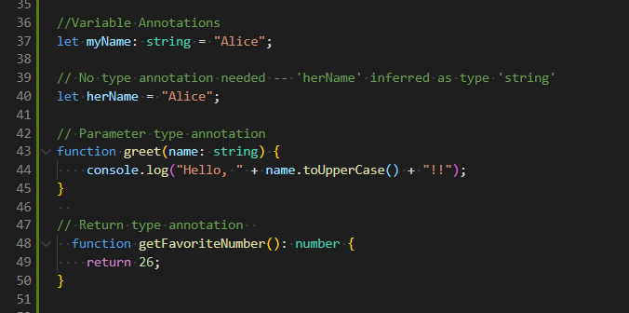
Type Annotations

Slide 28
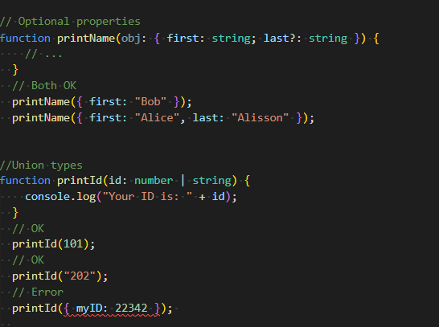

Slide 29
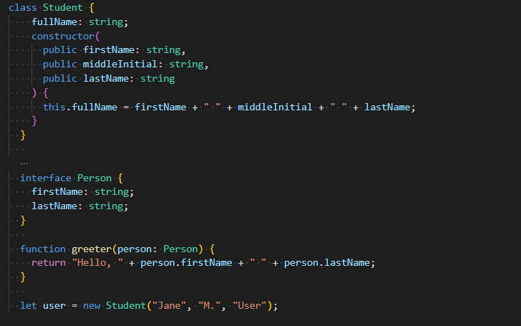
Classes

Slide 30
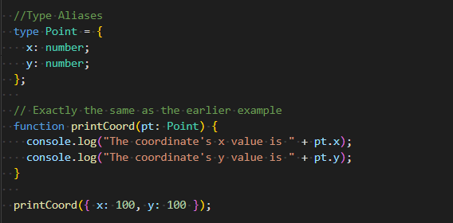
Type Aliases

Slide 31
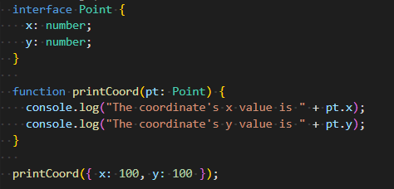
Interfaces

Slide 32
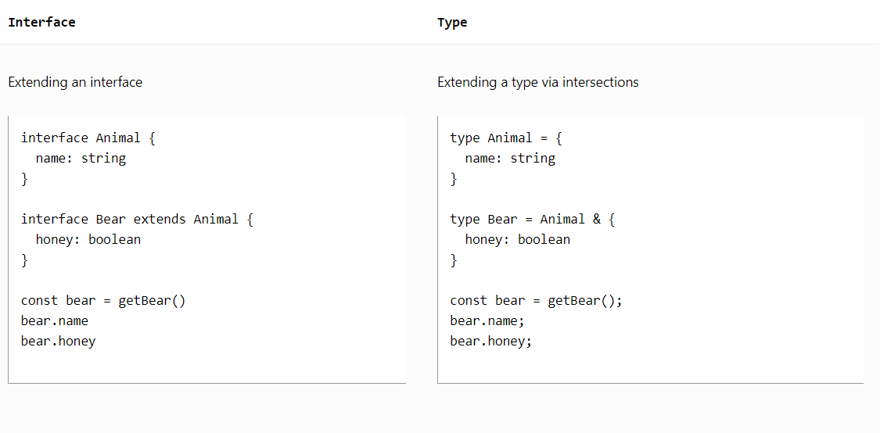

Slide 33
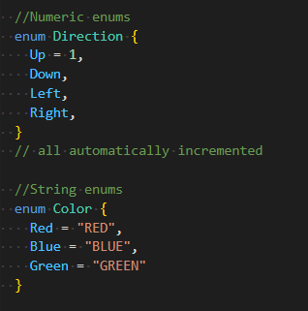
Enums

Slide 34

https://www.typescriptlang.org/play

